Slide 1
HELLO EVERYONE
OUR PROJECT
GAS LEAKAGE MOINTORING AND ALERTING SYSTEM FOR INDUSTIES

Slide 2
TEAM DETAILS:
DOMAIN NAME : INTERNET OF THINGS
TEAM ID : PNT2022TMID29465
BATCH : BE-2M4E
TEAM LEADER : SNATHOSH.V
TEAM MEMBER 1 : SHARAN SRINIVAS D S
TEAM MEMBER 2 : VISHVAA S.V
TEAM MEMBER 3 : GOKUL NATH V

Slide 3


Problem Statement Definition:
Problem Statement (PS) | I am (Customer) | I am trying to | But | Because | Which make me feel
PS-1 | Industrialist | Monitor gas leakage in the industry | I have no efficient system for monitoring | High cost and Complicated process of Installing | Disappointed
PS-2 | Industrialist | Control the gas leakage | Also the installation process is too complicate | The number of sensors is unpredictable and the positioning of equipment is improper | Frustrated

Slide 4
Proposed Solution :-
S.No | Parameter | Description
1. | Problem Statement (Problem to be solved) | o Gas Leakage Monitoring and Alerting System.
2. | Idea / Solution description | Using a variety of sensor, the environmental parameters such as concentration of the gas can be monitored in real time If the concentration of gas reaches hazardous level an alert message can be sent to the user.
3. | Novelty / Uniqueness | Device being developed can monitor a wide range of gases that are highly used in industries. o Apart from notifying the user, Safety personnel are also notified in case of emergencies. User friendly in nature.
4. | Social Impact / Customer Satisfaction | o As the device is small, it is easy to install them in various locations based on necessity.
5. | Business Model (Revenue Model) | Device can be obtained by paying for the subscription. It can be yearly or monthly. Based on the term of subscription 5 – 8% discount shall be made available.
6. | Scalability of the Solution | o In future more variety of gas can also be monitored, by adding the necessary sensor and monitoring the data obtained from it.

Slide 5
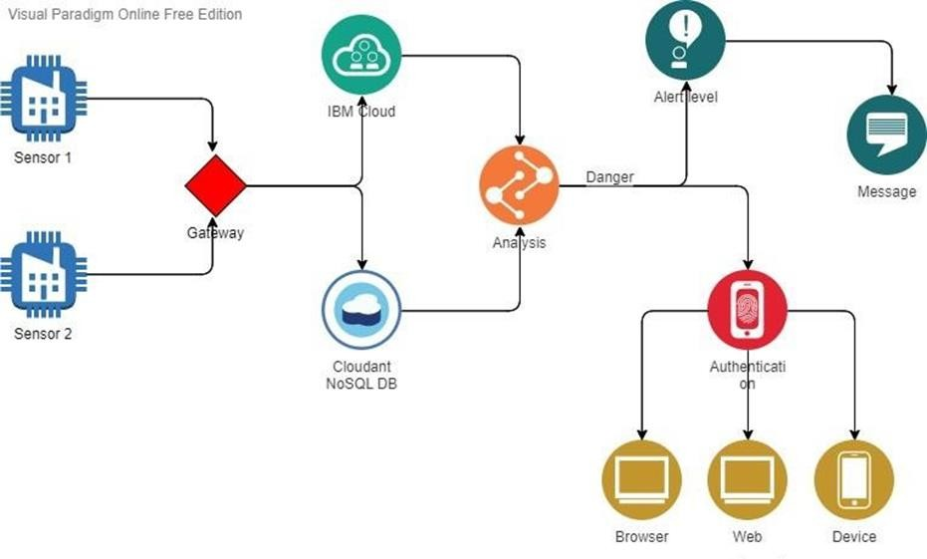
Technical Architecture:

Slide 6
RESULTS:
In this project we use IOT technology for enhancing the existing safety standards. While making this prototype has been to bring a revolution in the field of safety against the leakage of harmful and toxic gases in environment and hence nullify any major or minor hazard being caused due to them. We have used the IOT technology to make a Gas Leakage Detector for society which having alerting techniques involving sending text message to the concerned authority and an ability performing data analytics on sensor. This system will be able to detect the gas in environment using the gas sensors. This will prevent form the major harmful proble.

Slide 7

WORKING DEMO OF THE PROJECT

Slide 8
FUTURE SCOPE:
We propose to build the system using an MQ6 gas detection sensor and interface it with an Aurdino Uno microcontroller along with an LCD Display.
Our system uses the gas sensor to detect any gas leakages. The gas sensor sends out a signal to the microcontroller as soon as it encounters a gas leakage. The microcontroller processes this signal and a message is displayed on the LCD to alert the user.
For the first stage project presentation the required research work has been completed and the validation of project has been proved. Hence it can be said that the aim of the project “LPG Gas Detection System Using GSM Module” can be achieved successfully. The further designing and fabrication of the working model will be completed by February 2016. After which the different experiments will be conducted for efficiency improvement.

Slide 9


